Slide 1
TEAM
HASNAT WALI
FAIZAN KHAN
MILAD

Slide 2

LCI Pharmaceutical: A Strategic Analysis
This presentation analyzes LCI Pharmaceutical's position in the industry, evaluates its strengths and weaknesses, and outlines strategies for future success.

Slide 3
Introduction to LCI Pharmaceutical
About LCI
Mission
LCI Pharmaceutical is a leading manufacturer of generic and branded pharmaceuticals with a strong presence in the US market.
LCI strives to provide affordable, high-quality medications while fostering innovation in healthcare.

Slide 4

Industry Analysis
1
Market Trends
2
Competition
The pharmaceutical industry is experiencing growth driven by increasing demand for prescription drugs.
LCI faces intense competition from large multinational companies and smaller specialty pharma firms.
3
Regulatory Environment
The industry is highly regulated, with stringent FDA guidelines and global regulatory frameworks.

Slide 5
SWOT Analysis
Strengths
Weaknesses
Opportunities
Threats
Strong R&D capabilities
Limited brand recognition
Expanding into new markets
Increased generic competition
Experienced management team
Heavy reliance on generic drugs
Developing innovative drug therapies
Rising costs of raw materials
Established distribution network
Susceptibility to price pressure
Partnerships with biotechnology companies
Potential regulatory changes

Slide 6




Corporate-Level Strategy
Growth
1
LCI will pursue both organic and inorganic growth strategies.
Diversification
2
LCI will expand into new therapeutic areas and markets.
Innovation
3
LCI will invest in R&D to develop novel drugs and delivery systems.
Partnerships
4
LCI will collaborate with other companies to leverage expertise and resources.

Slide 7




Business-Level Strategy
Value Proposition
LCI will offer high-quality, affordable medications and personalized patient care.
Competitive Advantage
LCI will focus on building brand recognition and developing innovative products.
Market Segmentation
LCI will target specific patient populations with tailored marketing campaigns.

Slide 8
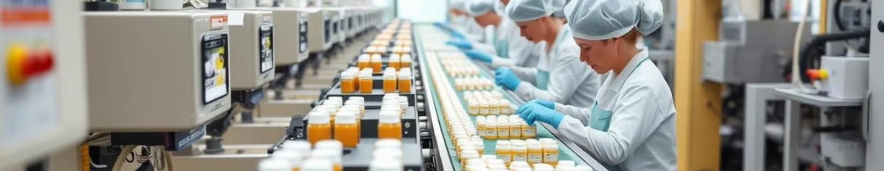
Operational Initiatives
Efficiency
Technology
Sustainability
LCI will implement lean manufacturing practices to reduce costs and improve output.
LCI will invest in digital technologies to enhance supply chain management and customer service.
LCI will prioritize environmentally friendly practices throughout its operations.

Slide 9

Conclusion and Key Takeaways
LCI Pharmaceutical is well-positioned for future growth by leveraging its strengths, addressing its weaknesses, and capitalizing on market opportunities. The company's strategic plan will guide its efforts to achieve sustainable growth and deliver value to patients and stakeholders.

